Slide 1
Welcome to EURÉKA!
QUESTIONS SHEET

Slide 2
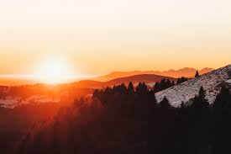
1. What is always coming, but never arrives?
Answer: Tomorrow

Slide 3
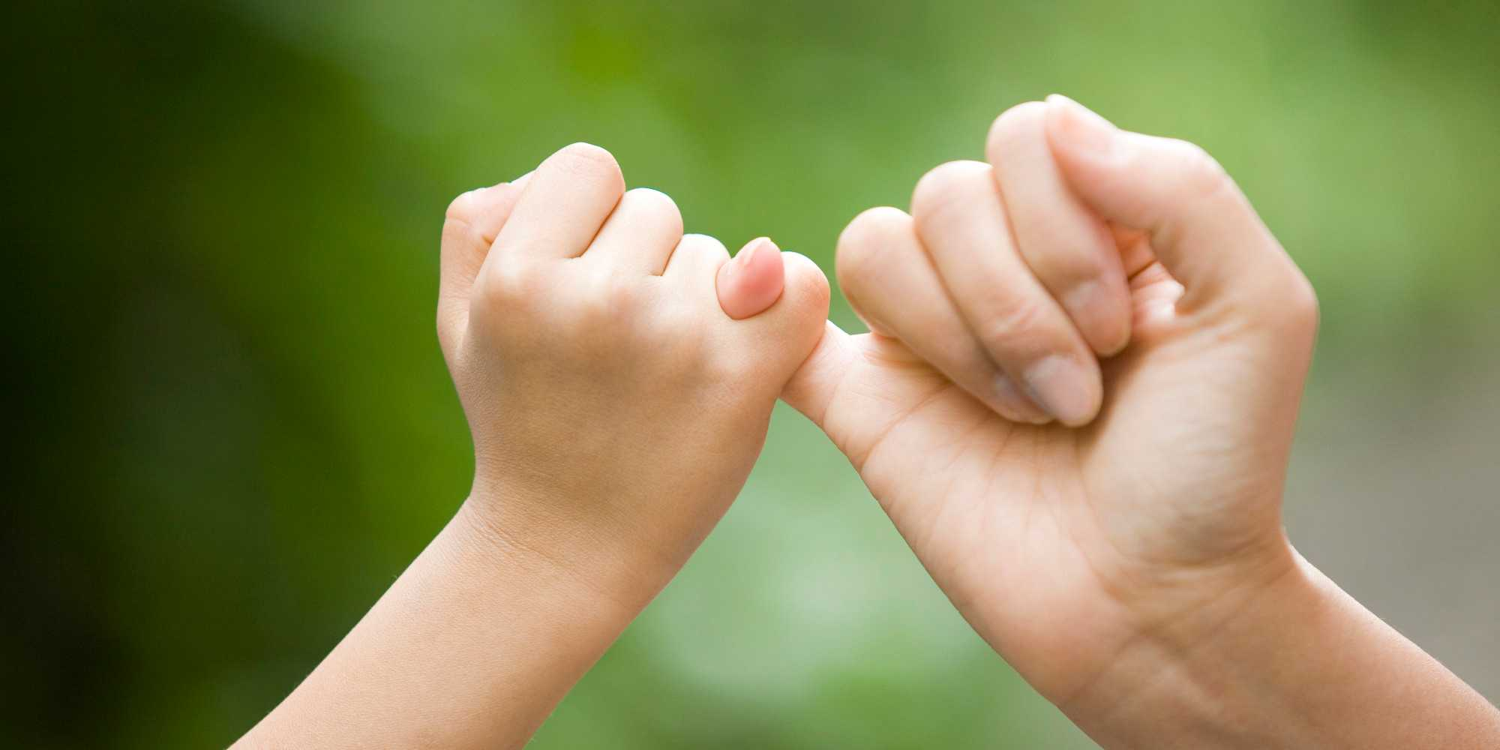
2. What can be broken, but is never held?
Answer: A promise

Slide 4
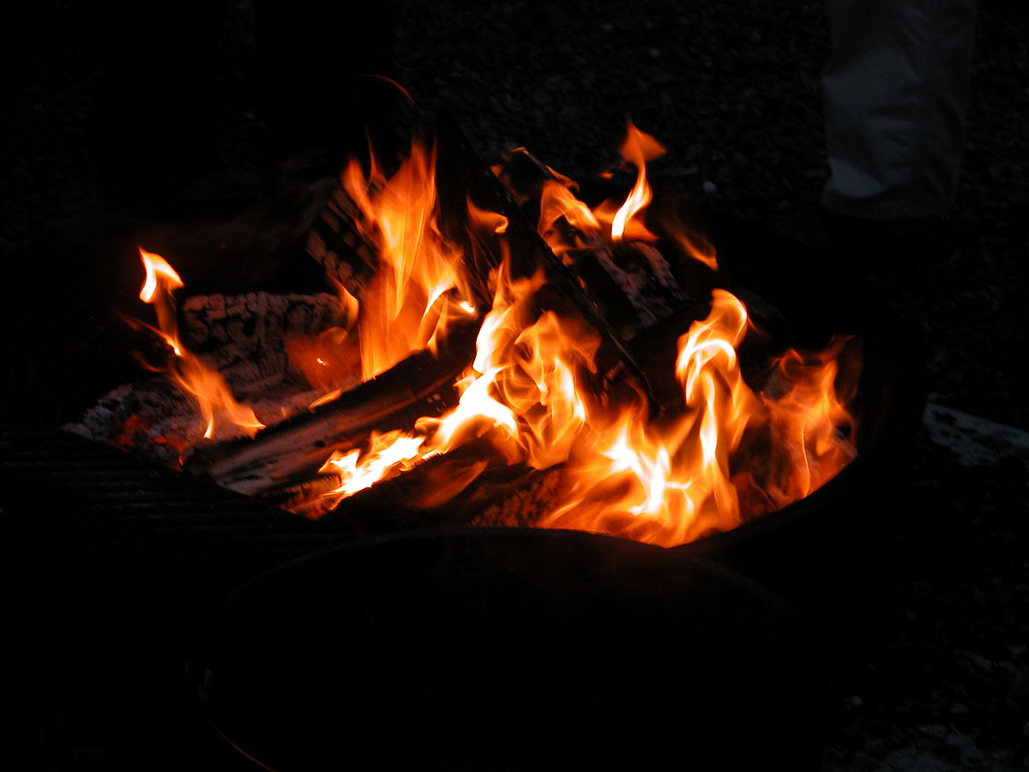
3. What is it that lives if it is fed, and dies if you give it a drink?
Answer: Fire

Slide 5

4. What is it that if you have, you want to share me, and if you share, you do not have?
Answer: A secret

Slide 6

5. If it takes eight men ten hours to build a wall, how long would it take four men?
Answer: No time, because the wall is already built.

Slide 7
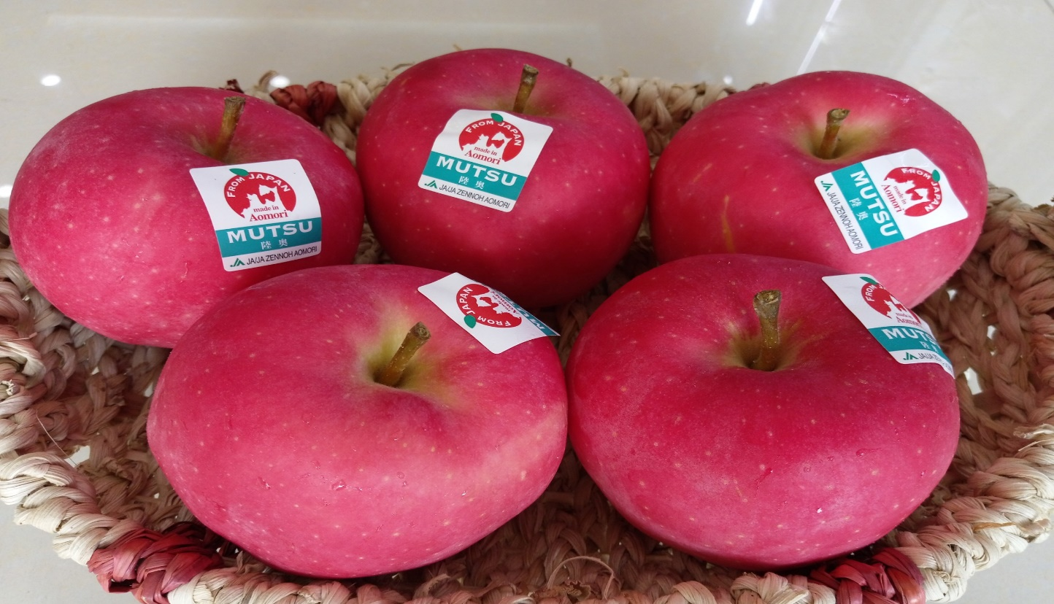
6. If you have a bowl with six apples and you take away four, how many do you have?
Answer: The 4 you took away

Slide 8
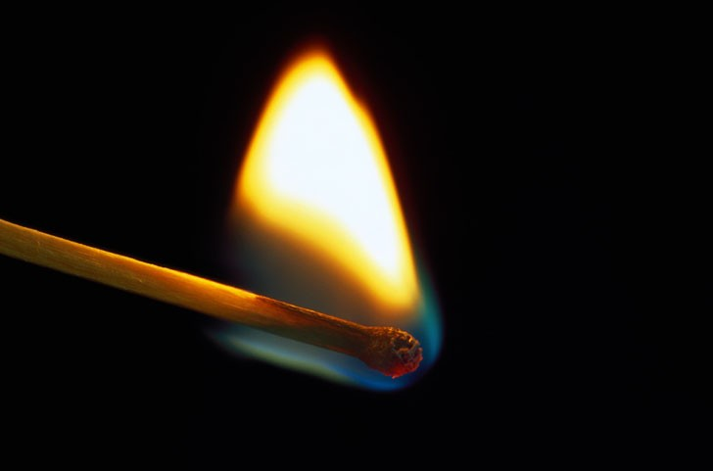
7. If you had only one match and entered a dark room containing an oil lamp, some kindling wood, and a newspaper, which would you light first?
Answer: The match

Slide 9
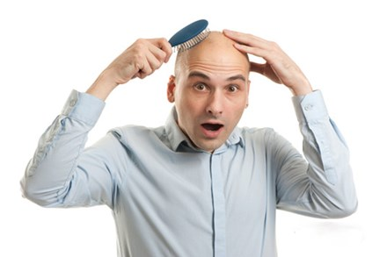
8. How could a man go outside in the pouring rain without protection, and not have a hair on his head get wet?
Answer: He was bald

Slide 10
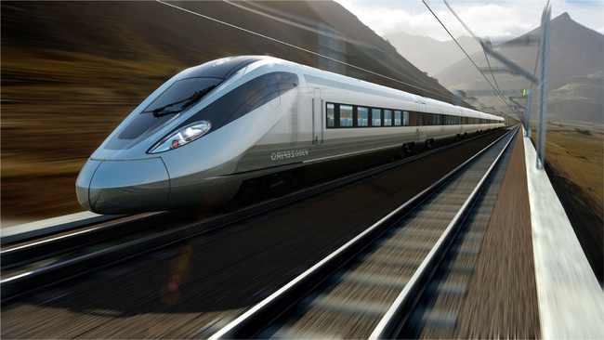
9. Question: If an electric train is moving north at 100mph and a wind is blowing to the west at 10mph, which way does the smoke blow?
Answer: An electric train has no smoke

Slide 11
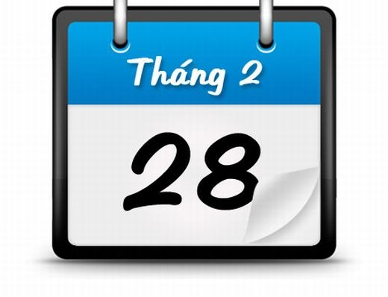
10. Some months have 31 days, others have 30 days, but how many have 28 days?
Answer: All the months have 28 days

Slide 12
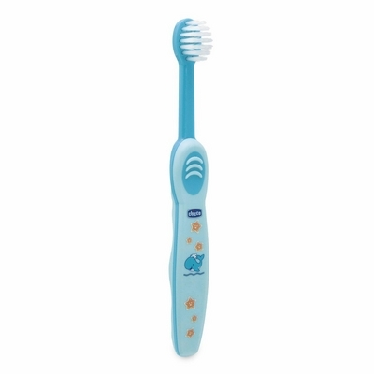
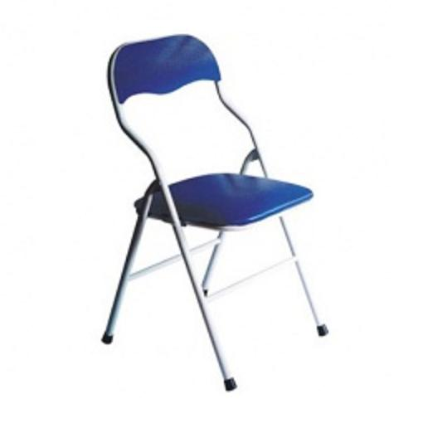
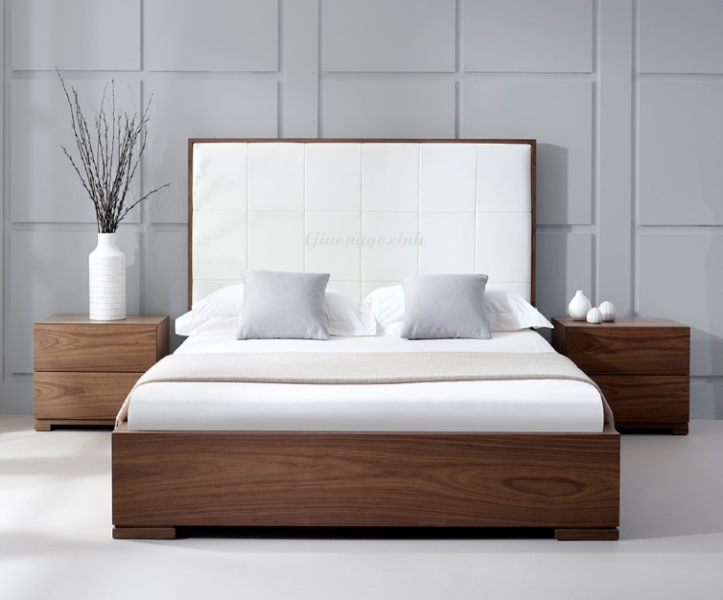
11. What do you sit on, sleep on, and brush your teeth with?
Answer: A chair, a bed, and a toothbrush

Slide 13
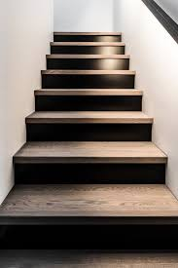
12. What goes up and down, but always remains in the same place?
Answer: Stairs

Slide 14

13. What is it that goes up, but never comes down?
Answer: Age

Slide 15
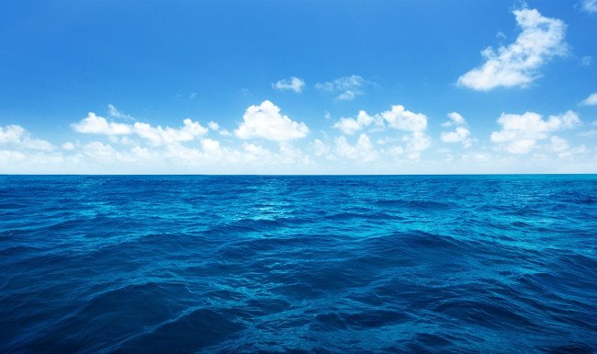
14. What did the ocean say to the beach?
Answer: Nothing; it waved.

Slide 16
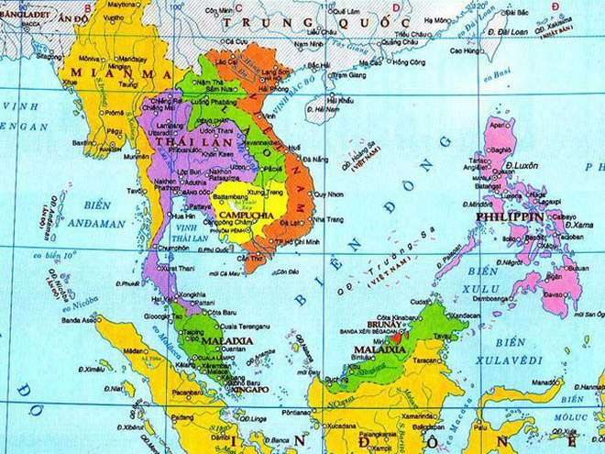
15. Where is an ocean with no water?
Answer: On a map

Slide 17
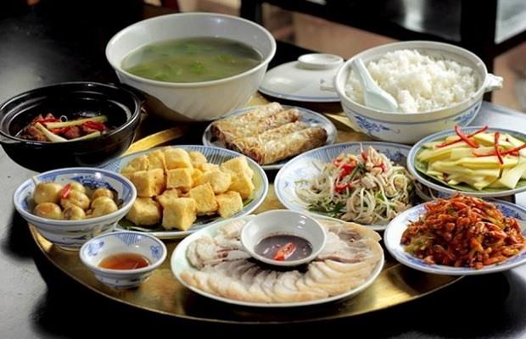
16. What can you never eat for breakfast?
Answer: Lunch or dinner

Slide 18
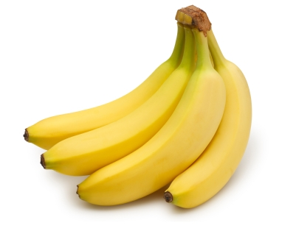
17. If a monkey, a squirrel, and a bird are racing to the top of a coconut tree, who will get the banana first?
Answer: None, because you cannot get a banana from a coconut tree

